Slide 1
Introducing:
Custom Systems for Ladder and Job Site Safety
John Seabold

Slide 2
Overview
Ladder Pals* are custom foam padding systems designed to protect you and your work area from ladder damage during work or transport.
Extension Ladder Pal*: Fits any standard aluminum or fiberglass extension ladder
Step Ladder Pal*: fits all stepladders
Transport Ladder Pal*: protects any surface during ladder transport or storage
Ladder Stabilizer Stake*: keeps the lowest rung of the ladder secure on grass or dirt
Protects any interior or exterior surface from ladder damage including gutters, doors, windows, shutters, sills, canopies, walls, floors and vehicles without ladder rails

Slide 3
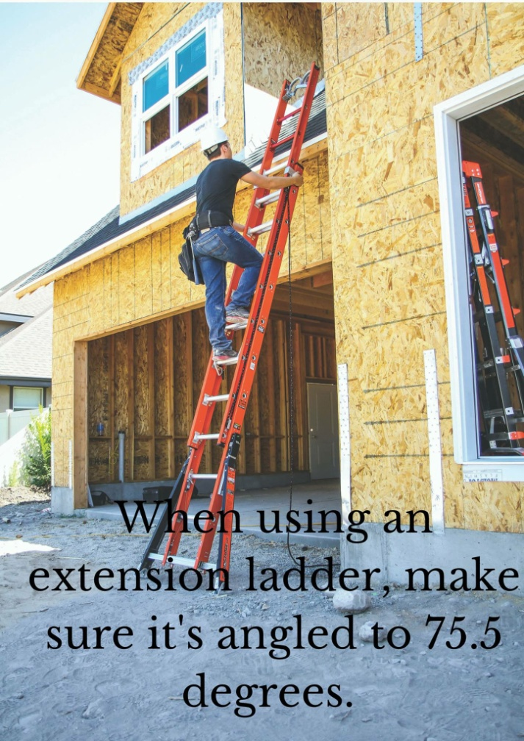
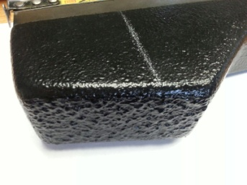
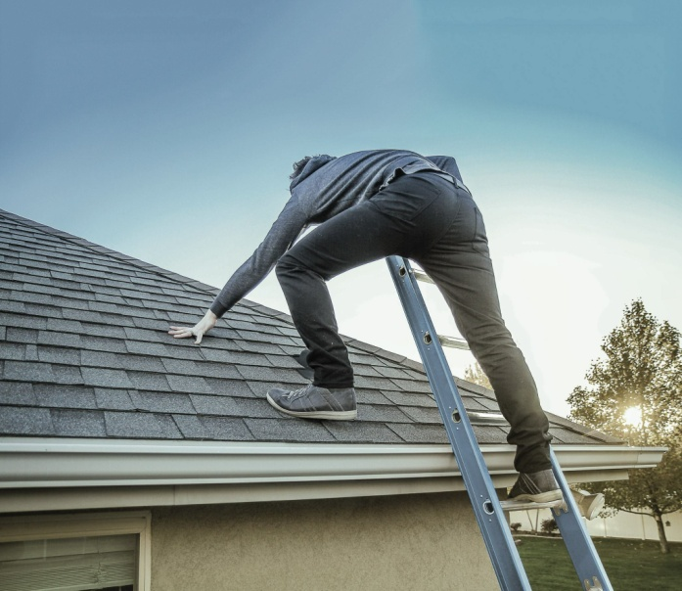
Extension Ladder Pals*
Promote Workplace Safety
Our frame is molded to the correct angle to keep extension ladders at the OSHA-recommended 75.5° against walls. This protects climbers
Textured surface keeps ladder from slipping
Place Ladder Pals on the right rungs of the ladder to ensure OSHA –recommended three feet extension above the roof for access
Show your customer you care – keep workplace accidents low

Slide 4
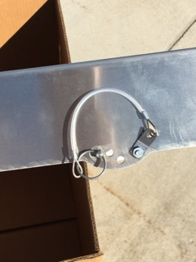
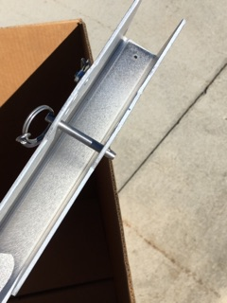
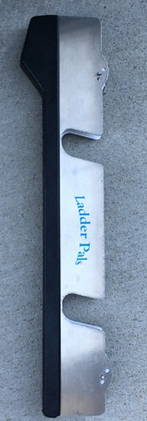
Extension Ladder Pals
Fits all standard aluminum and fiberglass ladders
Locking pin holds the Extension Ladder Pal securely in place around the rungs and will never slip
Fitted rung slots utilize the ladder structure itself for stability – it essentially becomes a part of the ladder

Slide 5
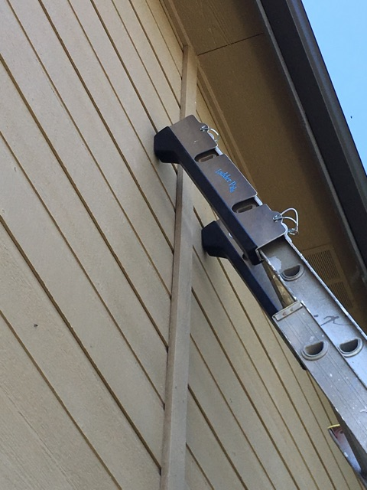
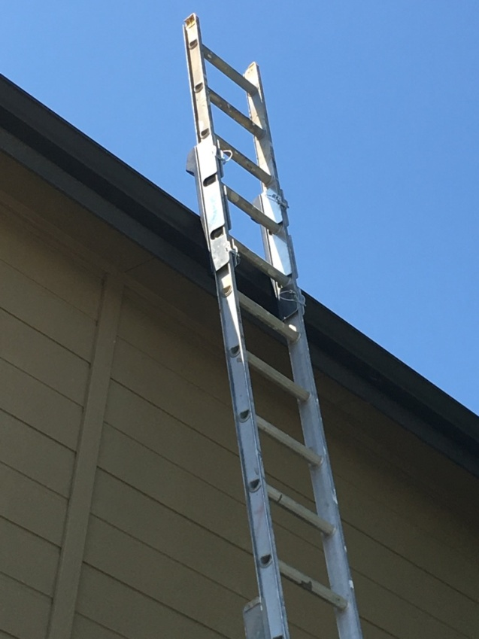
Extension Ladder Pals
Protect client’s house, walls, windows, gutters etc.
Our adjustable frame and padding system cushions structures from contact damage
Preserve your profit margins by preventing trade damage

Slide 6
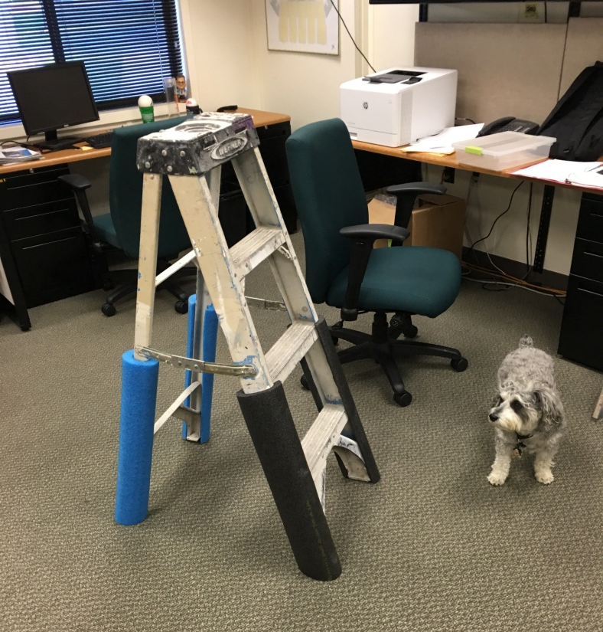
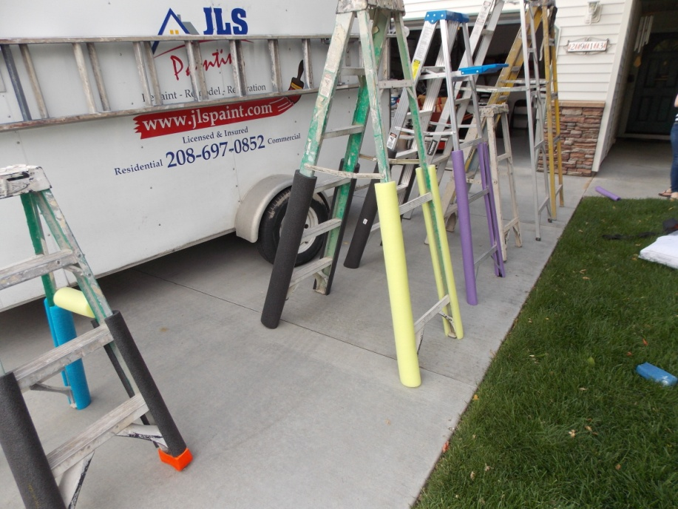
Step Ladder Pals*
Protect corners, walls, furniture, cabinets and even floors from the step ladder’s hard edges
Fits any size stepladder

Slide 7
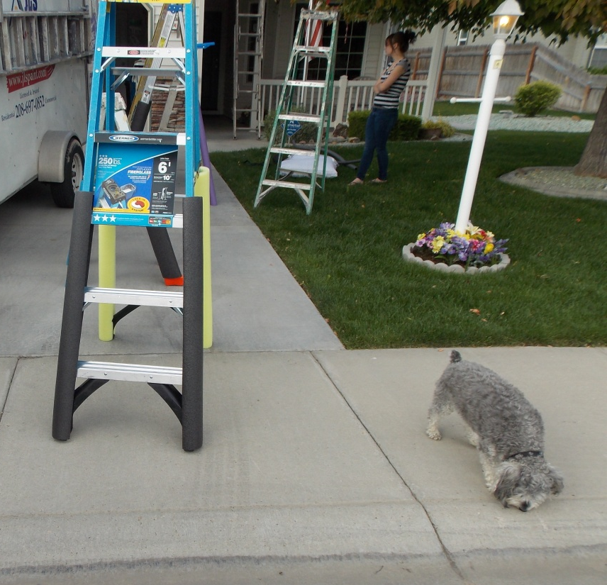
Step Ladder Pals*
Clamps securely in place and will not slip
Preserve your profit margins and prevent trade damage

Slide 8
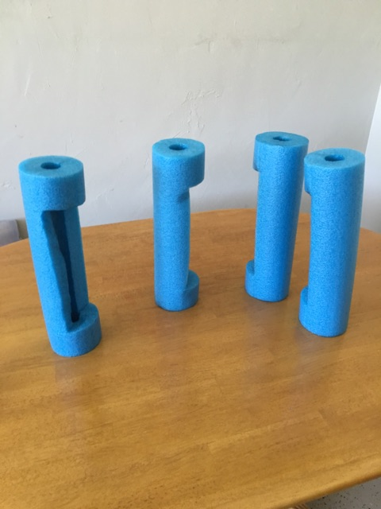
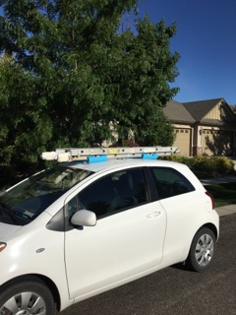
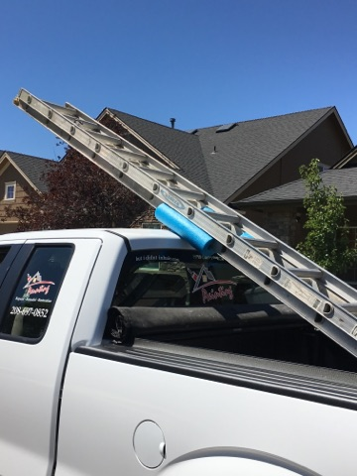
Transport Ladder Pals*
Protect trucks and other vehicles during transport from marring and scarring your paint
No more searching for a jacket or blanket when strapping a ladder to your vehicle

Slide 9
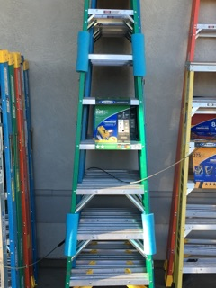
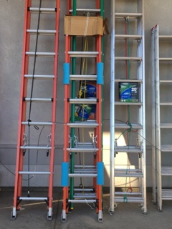
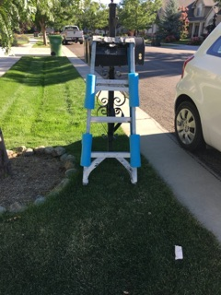
Transport Ladder Pals*
Fits any size ladder
Protects any surface from the ladder while storing it

Slide 10
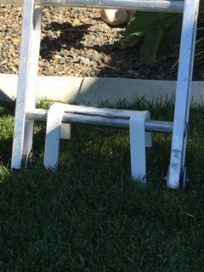
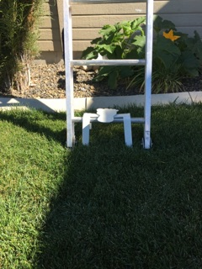
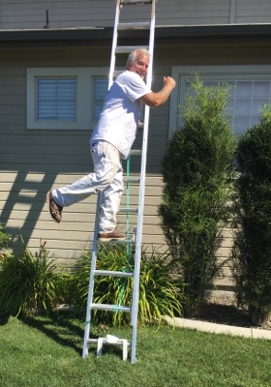
Stabilizer Stake*
No more “Hold the ladder Honey!”
Designed to hold a ladder’s lowest rung securely in grass or dirt
Fits any size ladder
Adjustable to exactly where it’s needed
Promote workplace safety

